Slide 1

Predicting Human Gene Expression of non One–To–One Orthologs
Bioinformatics project, winter semester 2020
Inbal Tziperman Lotan
https://github.com/inbal-tz/shen-orr
Inbal.tzipermanl@gmail.com
0547202035

Slide 2
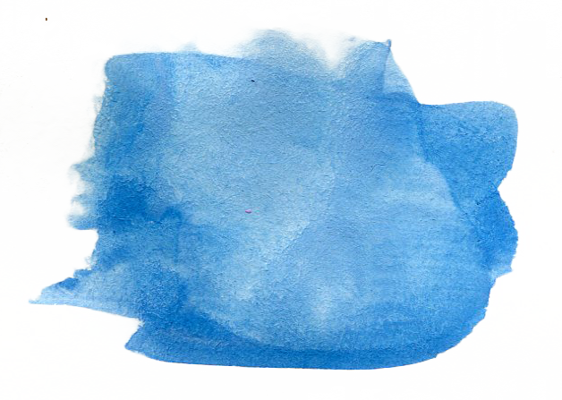
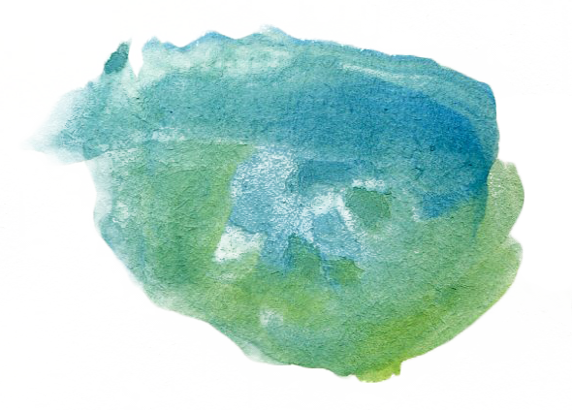
Project Summary
Find a Database that annotates orthologs between Mus Musculus and humans
Create a database equivalent to FIT, but for non one to one orthologs, including the comparison between human and mouse expression values.
Predict human expression levels from mouse data by
Reducing the ortholog group to one pair that best describes the group’s behavior:
Spearman correlation
Lasso regression
Using all of the mouse genes to make the prediction:
Weighted average of predictions made by each mouse gene.
Lasso Regression on whole group

Slide 3
Panther Database
Number of Human Genes | Number of Mouse Genes
929 | 349 | One to many
454 | 1545 | Many to one
844 | 1250 | Many to many
2227 | 3144 | Sum
After exploring 10 databases I chose The Panther database.
http://www.pantherdb.org/
**15,732 One to one orthologs

Slide 4

Creating the database
Compared files | Disease | HS.Ztest | MM.Ztest | Ortholog type | Mouse Entrez ID | Human Entrez ID
Similar to FIT database, but only non one to one orthologs.
201,266 samples
1817 human genes
2454 mouse genes
24 diseases

Slide 5
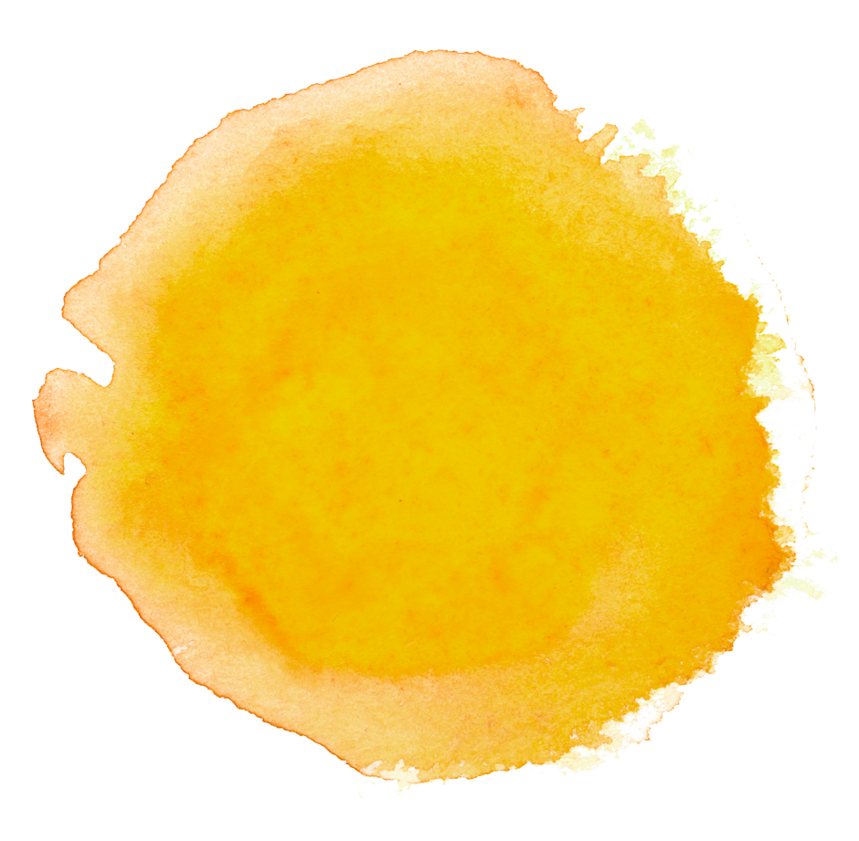
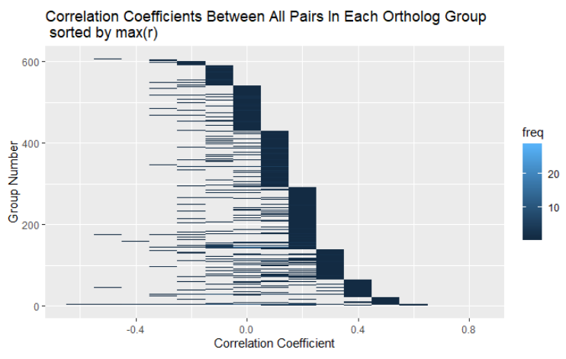
Predicting human expression with spearman correlation
Each line is a group of orthologs.
Sorted by the max correlation coefficient out of all pairs in ortholog group.

Slide 6
How many human genes
have good mouse representatives?
#human genes with 'good' mouse representatives | correlation threshold
1817 | 0
751 | 0.1
464 | 0.2
229 | 0.3
94 | 0.4
33 | 0.5
11 | 0.6
2 | 0.7
For each correlation threshold, how many human genes have good mouse representatives if the threshold for a good correlation was this.
**a threshold of 0 contains all of the genes (that have enough data points).
**if one human gene has more than 1 mouse representative that fits, we will still only count it once.
**genes that have >30 datapoints.

Slide 7
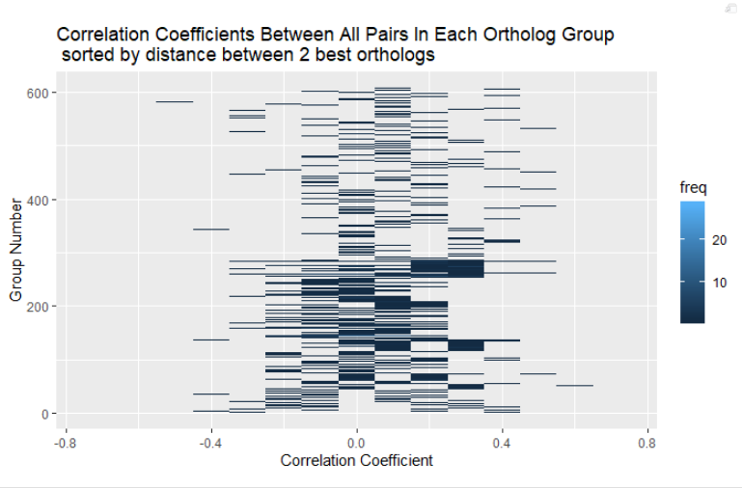
Human genes
Mouse genes
A
0.1
C
0.2
0.4
D
0.8
0.1
B
0.8
E
In this (fake) example, there are 2 best pairs! This method will not enable us to choose.

Slide 8
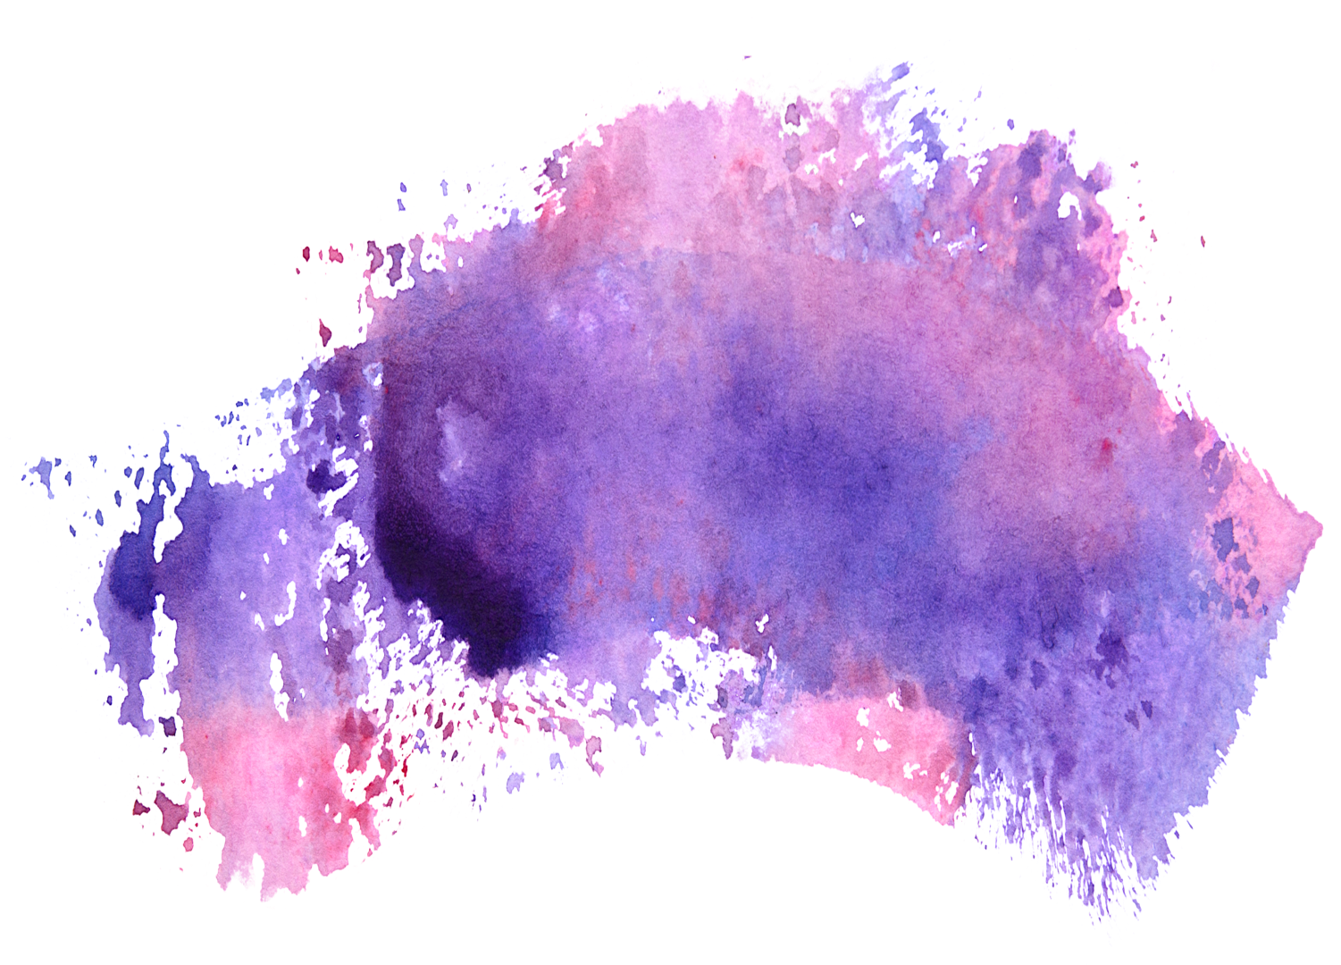
Predicting human expression with Lasso Regression
For each ortholog pair mark:
n- the number of samples this gene pair has in our database.
I bootstrapped 100 times to sample n samples (with replacement) from the database.
On each set of n samples, I calculated lasso regression and therefore got 100 slopes (β).
The prediction will be made based on the average slope.
HS. Ztest | MM. Ztest | Mouse ID | Human ID
2 | 1.4 | 14601 | 9
… | … | … | …
2.2 | 2 | 14601 | 9
HS. Ztest | MM. Ztest | Mouse ID | Human ID
1 | 0.2 | 14601 | 9
… | … | … | …
2 | 1.4 | 14601 | 9
Choose n samples
Lasso regression
β
X 100

Slide 9
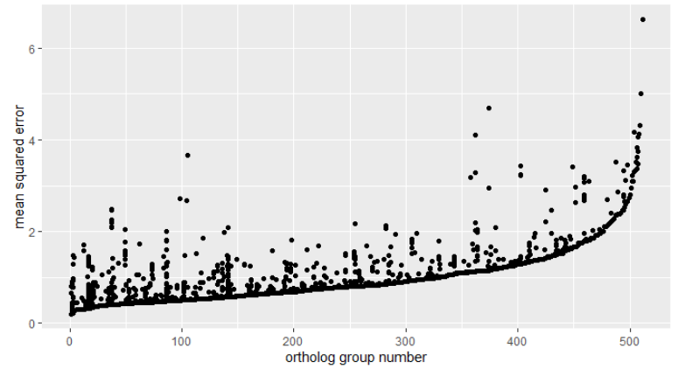
Mean squared error- sorted by lowest in group
Each column is a group, each dot is a pair of orthologs.
groups on the left have 1 pair of orthologs that could be good representatives of the group.

Slide 10
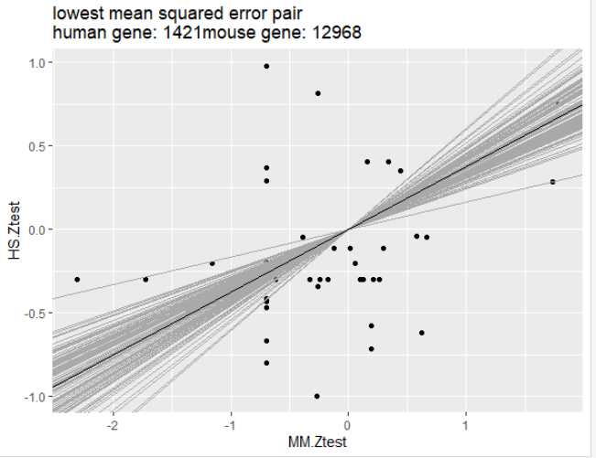
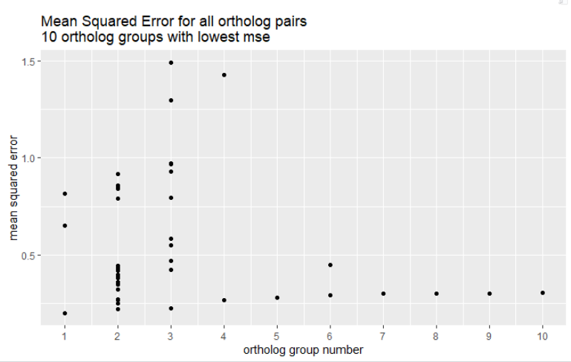
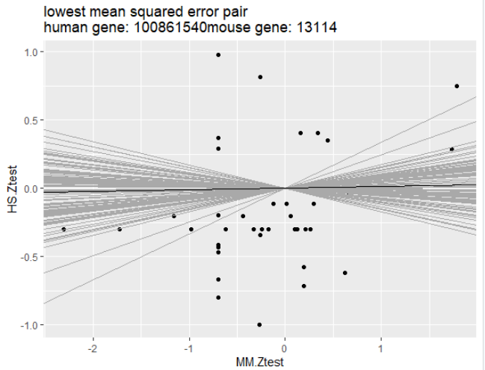
10 groups with lowest minimum MSE
Group1:
Group2:
MSE does not say anything about the slope value!

Slide 11
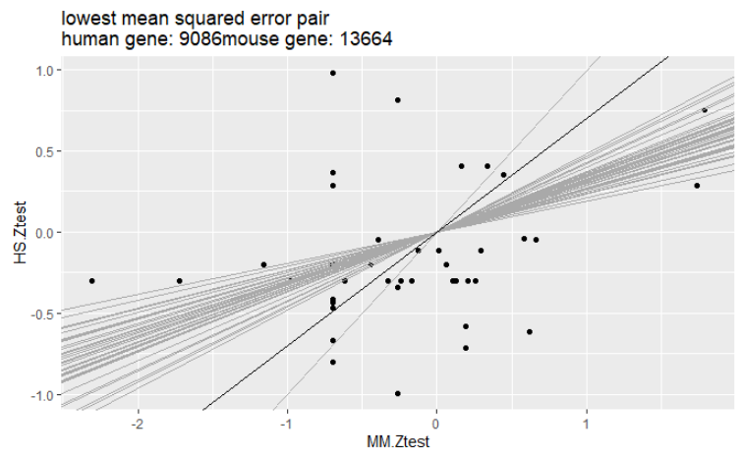
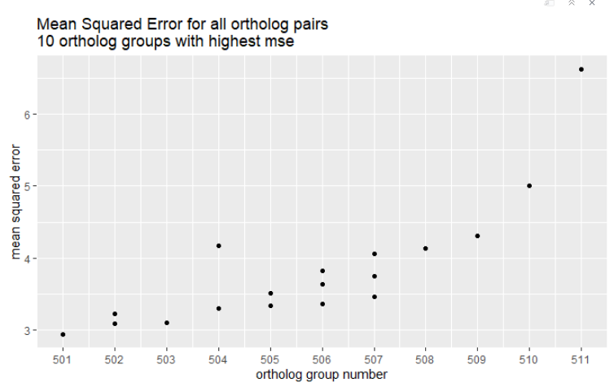
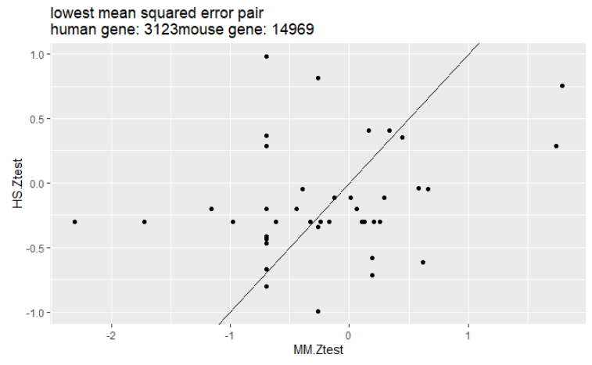
Last 10 groups (groups with the highest min mse)
The shrinkage of the slope to 1 here makes the mean squared error very high.
This might not be a natural result BUT remember that when the slope is 1, it means that the regression could not converge on a meaningful solution.
Group511:
Group510:

Slide 12
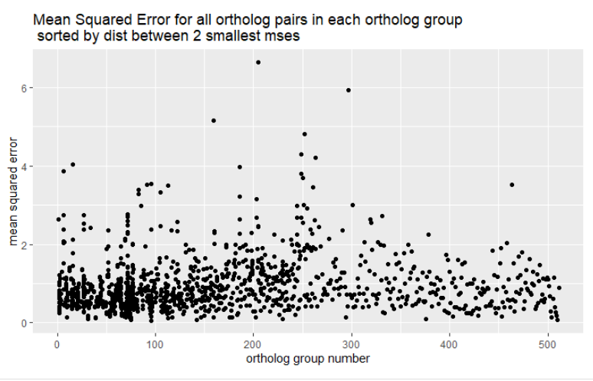
Mean squared error- sorted by distance between the 2 lowest MSEs in group
Sorting by distance between the best 2 ortholog pairs enables us to see which groups have an absolute winner!

Slide 13
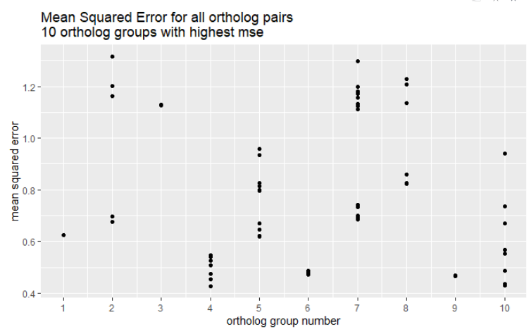
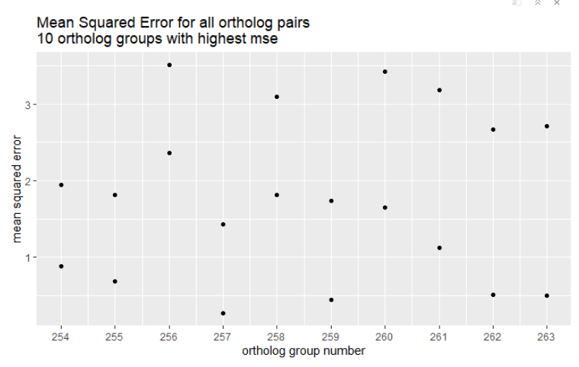
Mean squared error- sorted by distance between the 2 lowest MSEs in group
10 groups with the smallest distance between 2 best ortholog groups
10 groups with the highest distance between 2 best ortholog groups

Slide 14
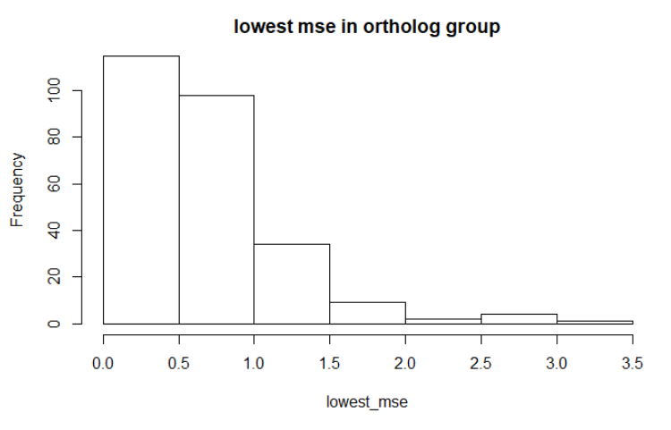
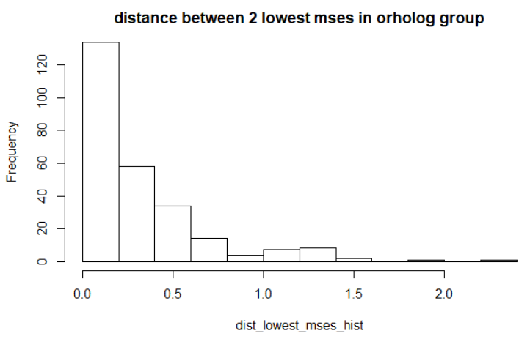
Conclusion- given the 2 values,
For which groups are we successful in finding a
Good ortholog pair to represent them?
Notes:
לחזור לגרף המקורי של אדם מול עכבר (ztest). של קבוצת אורתולוגים עם ערכים של MSE טובים ורעים במיוחד.

Slide 15
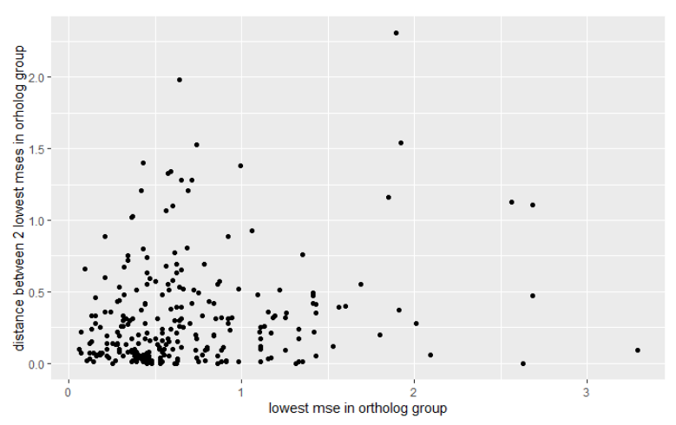
Conclusion- given the 2 values,
For which groups are we successful in finding a
Good ortholog pair to represent them?
Maybe use both?
Each dot is a group of orthologs. X axis is the lowest value of MSE out of all of ortholog pairs in group. Y axis is the distance between its 2 “best” ortholog pairs.
Idealy, groups should contain an ortholog pair with low MSE, that is also far away from the next best ortholog pair.

Slide 16
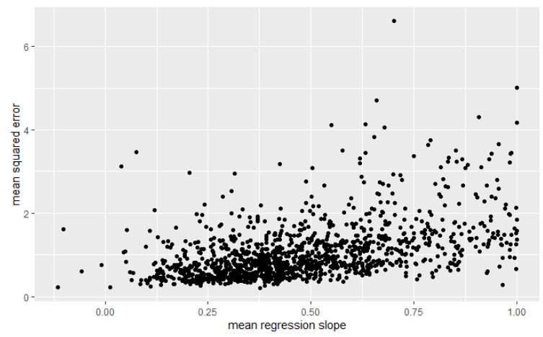
Considering the regression slope?
Each dot is a pair of orthologs.
Ideally we would want a high mean regression slope (not necessarily the highest!) and low MSE.
Remember- slopes at 1 or close to one usually simply means the regression did not converge.

Slide 17

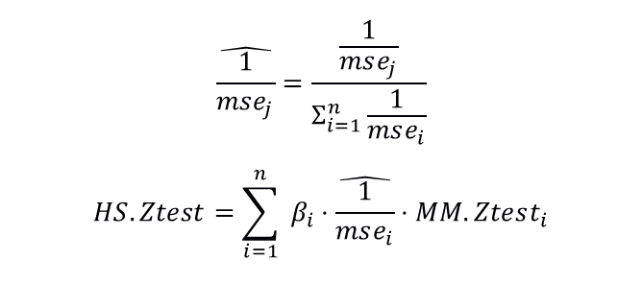
Using all mouse orthologs in group to Predict human expression
(without choosing the best pair)
Weighted Average of Lasso predictions:
$$\hat{\frac{1}{mse_{j}}}=\frac{\frac{1}{mse_{j}}}{Σ_{i=1}^{n}\frac{1}{mse_{i}}}$$
$$HS.Ztest=\sum_{i=1}^{n}{ β_{i}⋅\hat{\frac{1}{mse_{i}}}}⋅MM.Ztest_{i}$$
β, mse parameters are generated while training lasso regression to each ortholog pair separately.
β, mse are averaged across 100 bootstrapping samples.

Slide 18
Using all mouse orthologs in group to Predict human expression
(without choosing the best pair)
Weighted Average of Lasso predictions:
While MSE is in fact better- the correlations are very bad!

Slide 19
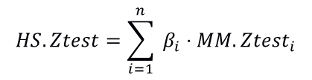
Using all mouse orthologs in group to Predict human expression
(without choosing the best pair)
Lasso regression using all orthologs together to train the model:
$$HS.Ztest=\sum_{i=1}^{n}{ β_{i}⋅MM.Ztest_{i}}$$
Only use orthologs that most samples in the training set have data about their expression.
In testing time- samples that will not have all orthologs will not be able to use this model.
2 solutions (that I did not implement…) imputation of the missing data, or building a few models like this with different sets of orthologs.

Slide 20
Using all mouse orthologs in group to Predict human expression
Lasso regression using all orthologs together to train the model.
**remember that the smaller sample size is more sensitive to outliers.

Slide 21
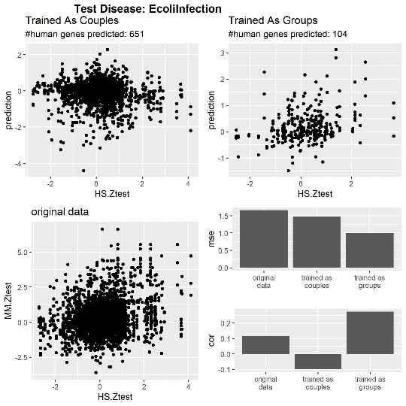
Using all mouse orthologs in group to Predict human expression- examples

Slide 22
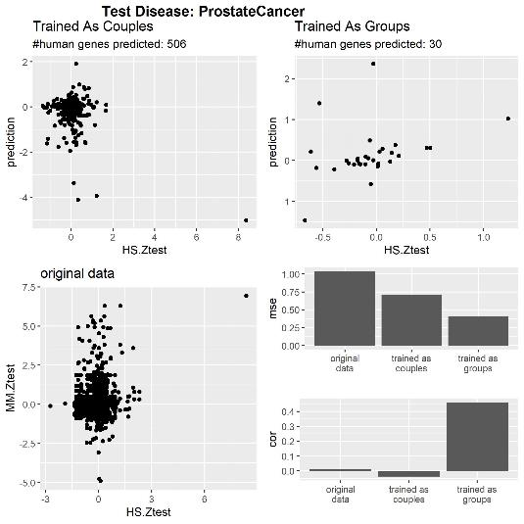
Using all mouse orthologs in group to Predict human expression- examples
**Sample size is too small- results not reliable

Slide 23
Conclusion
I present 4 models to predict human gene expression given mouse expression data.
2 models based on converting non one to one orthologs to one to one orthologs by choosing the best mouse representative.
choosing the best representative is based on spearman correlation or on lasso regression.
Some groups have 2 equally good representatives.
2 models are based on using the whole ortholog group to predict the human gene.
Weighted average, using the MSE as weights, of the individual predictions, yields poor predictions.
Lasso regression using all mice orthologs together to train the model yields a better model, though will not be able to predict all samples.

Slide 24
